Slide 1
CO2101 Operating Systems and Networking(Sem 1)
Lecture Week 10: Transport and Application Layers
Anthony Conway(he/him)
asc45@leicester.ac.uk

Slide 2
This week
Seminar- On Monday we covered solutions to the worksheet on IP Routing(Dijkstra) and MTU
Now Lecture – Recap/Transport and Application Layers
Tutorial this afternoon covering Socket Programming.
Labs this Friday –Worksheet on Socket Programming

Slide 3
Previously we covered ..
Layers 1 and 2 of the OSI Model
Layer 3 of the OSI Model
  Introduction to the Network Layer
  Internet Protocol
    IP Addressing and Network Masks
    IP Routing
    Subnetting
    Fragmentation
    NAT
    Routing in the Internet = BGP/IBGP

Slide 4
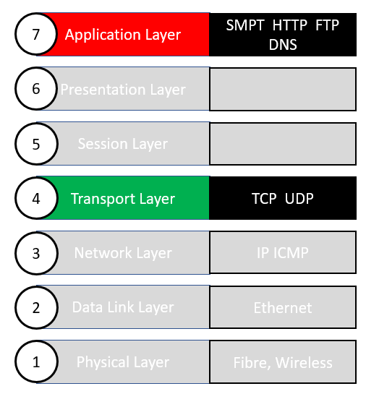
Lecture Overview
First a recap.
Introduction to the Transport and Application Layers
  The purpose and role of the Transport Layer.
  Key Transport Layer protocols and their functions.
  Connection Establishment using the 3-way handshake process.

Slide 5
First a Recap
Layer 1 is the Physical Layer. The wires and wireless carrying the digital transmission (1’s and 0’s for example as electrical signals).
Layer 2 is the Data Layer responsible for transmitting the over the wired/wireless connections between directly connected devices.
Layer 2 carries data from higher layers within ethernet frames using MAC Addresses to carry that data to the correct destination.
Layer 3 is the Network Layer and is responsible for routing/transmitting data between different devices on different networks.

Slide 6



LAN 132.56.3.0
Transmitting data within the same network(e.g. LAN)
>>Frame Removed
>>IP Packet Removed
We have the data
Layers 4-7 Application Data
+TCP/UDP
132.56.3.6/24
MAC Address = 3
7
De-Encapsulation
Segment
1
6
Switch Forwards the Frame i.e. retransmits along the new wire
Layer 3
IP Packet
From 132.56.3.2
To 132.56.3.6
132.56.3.5/24
MAC Address = 21
4
Encapsulation
000101010001100100100101
Switch
Router 1
5
2
>Application
Data
132.56.3.6
Layer 2
Ethernet Frame
From MAC Address=1
To MAC Address = 3
Server
132.56.3.2/24
MAC Address = 1
On a LAN we map MAC Addresses to IP Addresses using ARP
132.56.3.3/24
MAC Address = 7
132.56.3.4/24
MAC Address = 11
3
ARP Broadcast Who has this IP?

Slide 7
LAN 132.56.3.0
Transmitting data across different networks
132.56.3.6/24
MAC Address = 3
At the default gateway. The ethernet frame is then dropped and we are left with the IP Packet
Part 1
Layers 4-7 Application Data
+TCP/UDP
Segment
1
6
7
Layer 3
IP Packet
From 132.56.3.2
To 132.56.3.6
132.56.3.5/24
MAC Address = 21
>ping
4
000101010001100100100101
Switch
Router 1
>Application
Data
128.2.42.54
5
2
132.56.3.1/24
MAC Address = 30
Default Gateway
Switch Forwards the Frame
Layer 2
Ethernet Frame
From MAC Address=1
To MAC Address = 3
Server
132.56.3.2/24
MAC Address = 1
Default Gateway 132.56.3.1
On a LAN we map MAC Addresses to IP Addresses using ARP
132.56.3.3/24
MAC Address = 7
3
132.56.3.4/24
MAC Address = 11

Slide 8
Part 2
Frame is dropped
Router uses its routing table to determine the next hop of the IP packet. The packet is then added to a new frame for next hop
9
IP Packet has arrived at the router from LAN 132.56.3.0
It uses its routing table to determine the next hop of the IP packet. The packet is then added to a new frame for next hop
8
7
1
10
Router2
1
2
P2P Ethernet Connection
11
Router 1
2
Frame is dropped
3
1
2
Router 4
3
1
Pairs of routers belong to unique LAN’s
2
Router 3
LAN | Router 1 | Router 2
1 | 1 | 2
2 | 1 | 4
3 | 1 | 3
4 | 2 | 4
Server
Network Address: 64.245.1.0
Router 1
64.245.1.1/30
64.245.1.2/30
Router2
P2P Ethernet Connection

Slide 9
LAN 128.2.42.0/24
Part 3
128.2.42.5/24
MAC Address = 22
128.2.42.54/24
MAC Address = 11
Router finds IP address in ARP table and associated target MAC Address
Packet added to frame with source and destination MAC Address
14
Data
15
11
13
12
Router 4
Switch
Switch forwards frame
128.2.42.1/24
MAC Address = 44
Frame Arrives
>>Frame is dropped
>>Packet is dropped
>>Segment is dropped
We have the data!!
But what application is it form and for?
Ethernet Frame
From MAC Address=44
To MAC Address = 11
Server
128.2.42.77/24
MAC Address = 33

Slide 10

Layer 4 - Transmitting data between Applications
Host or Server
Application Layer Protocols
HTTP
HTTPS
SMTP
FTP
SFTP
DNS
Host or Server
e.g. Client Application
e.g. Server Application
Process
Process
192.168.1.24/24
132.18.4.101/25
Process
Process
Process
Process
PORT
1001
PORT
1002
Process
Socket
Socket
App Data
App Data
TCP/UDP
TCP/UDP
Operating
System
Operating
System
[Segment]
Internet
[Segment]
Layer 4
Segment
From Port 1001
To Port 1002
Layer 4
Segment
From Port 1002
To Port 1001
Packets

Slide 11
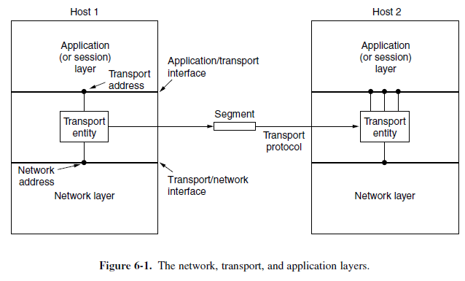
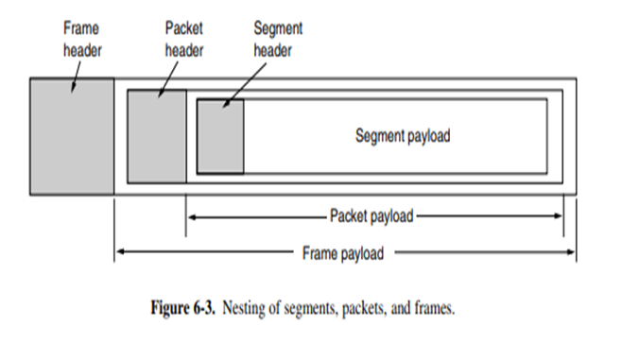
Transport Layer
The aim is to ensures reliable, efficient, and cost-effective communication between applications.
Uses network layer services via the transport entity.
Services:
  Connection-Oriented (e.g., TCP)
  Connectionless (e.g., UDP)
Note: The protocol data unit (PDU) at this layer is a segment.

Slide 12
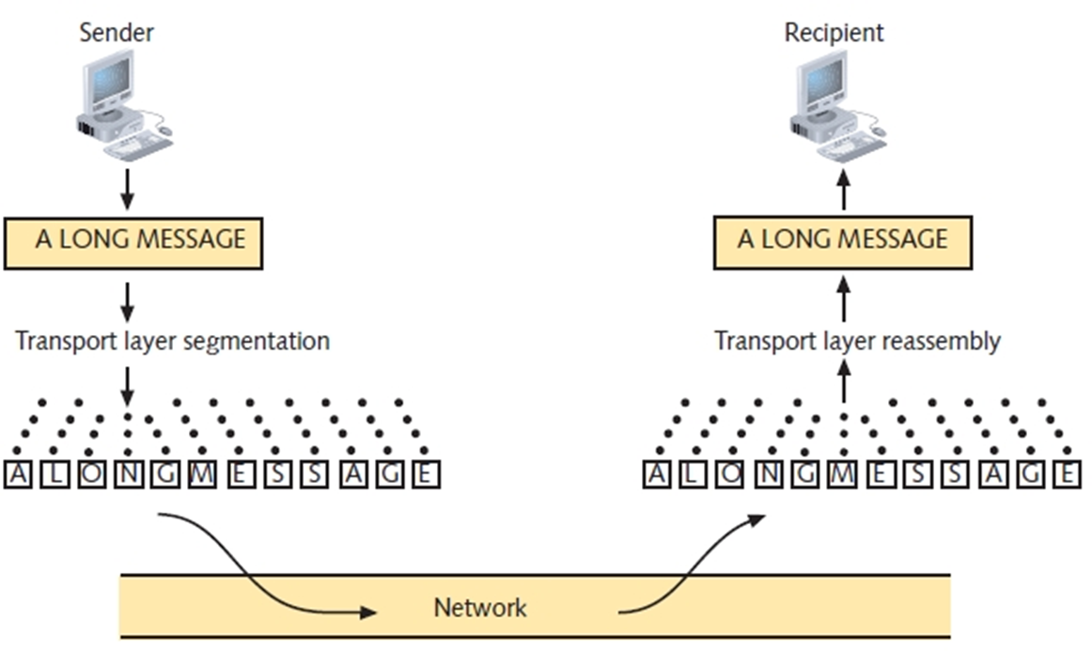
Transport Layer
The key functions are:
  Segmentation:
    Breaks large data into smaller, manageable pieces (segments).
  Reassembly:
    Ensures segments are reconstructed in the correct order.
  Error Handling:
    Detects and corrects errors during data transmission.
  Flow and Congestion Control:
    Adjusts data transfer rates to avoid congestion.
  Multiplexing:
    Uses port numbers to handle data from multiple applications.

Slide 13
Transport Layer vs Network Layer
Similarities: Both support:
  Connectionless or Connection-Oriented services
  Connection-Oriented tasks:
    Connection establishment.
    Data transfer and release.
  Addressing and flow control for managing data flow.

Slide 14
Transport Layer vs Network Layer
Differences:
  Reliability:
    Network Layer: May be unreliable; routers can crash or discard packets to reduce congestion.
    Transport Layer: Provides reliable services with error control and retransmission.
  Functionality:
    Transport Layer: Operates on end nodes (e.g., user machines).
    Network Layer: Functions mainly on routers for packet forwarding.
  Purpose:
    Transport Layer Primitives: Designed for programmers; easy to use.

Slide 15
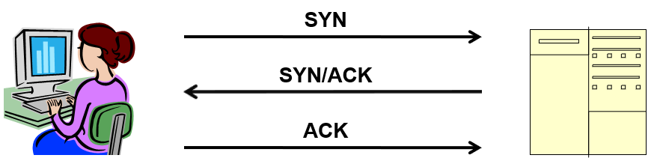
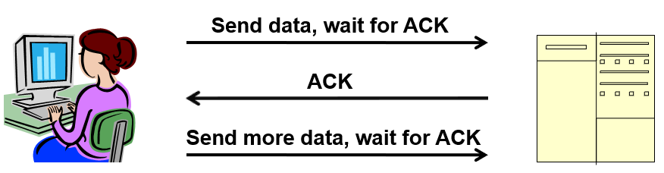
Transport Layer Main Protocols
1. TCP (Transmission Control Protocol):
Connection-oriented: Ensures reliable data transmission
Key features:
  Three-Way Handshake: Establishes connection (SYN → SYN-ACK → ACK).
  Acknowledgments: Confirms data delivery.
  Checksum: Verifies data integrity.
Use cases
  Web browsing (HTTP/HTTPS), email (SMTP), file transfer (FTP).

Slide 16
Transport Layer Main Protocols
TCP Header
Data
1. TCP Header
Source Port
Destination Port
Sequence Number
Acknowledgement Number
DO
RSV
FLAGS
Window
Checksum
Urgent Point
Options

Slide 17
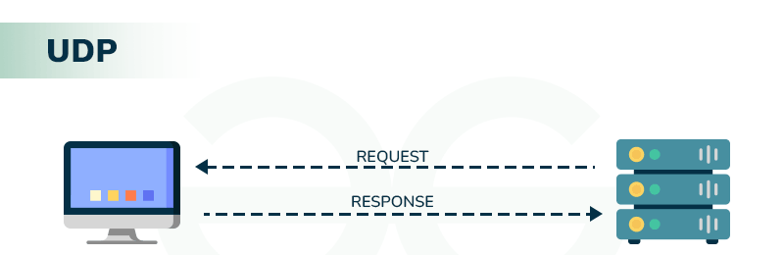
Transport Layer Main Protocols
2. UDP (User Datagram Protocol):
Key features:
  Connectionless: No handshake or prior connection required.
  Unreliable: No error-checking or acknowledgment.
  Fast: Prioritises speed over reliability.
Use cases:
  Streaming music or video.
  Real-time applications like gaming.
  DNS queries.

Slide 18
Transport Layer Main Protocols
2. UDP Header
UDP Header
Data
Source Port 16 bits
Destination Port 16 bits
Note - The maximum value for a port is 65,535 using 16 bits
Length 16bits
Checksum 16 bits

Slide 19
Transport Layer Main Protocols
Where are they typically used
Email
Video/Audio Streaming
File Transfers
TCP
UDP
Web Browsing
Gaming
VOIP
Reliable, error-free, and ordered data delivery
Time-sensitive
applications

Slide 20
Transport Service Primitives
Allows applications to establish, use, and release connections.
Key Primitives are:
  LISTEN: Waits for a client request.
  CONNECT: Establishes a connection.
  SEND: Transmits data.
  RECEIVE: Retrieves incoming data.
  DISCONNECT: Ends the session.
Process flow (Example)
  Server: Executes LISTEN to await client requests.
  Client: Executes CONNECT to initiate communication.
  Both: Use SEND and RECEIVE for data transfer.
  Session ends with DISCONNECT.
IP Address of Server/Port of Server
s.connect((HOST, PORT)) # Connect to the server
s.sendall(b'Hello from client') # Send a message (in bytes)
data = s.recv(1024) # Receive the server's response

Slide 21
Transport Layer Addressing
The Transport Layer uses port numbers to identify applications or services on a device.
Port Numbers:
  Act as virtual endpoints to allow multiple applications to use the same network interface.
  Ensure data is routed to the correct application.
Multiple applications can share the same IP address using unique port numbers.
End-to-End communication:
  Combines IP Address + Port Number.

Slide 22
Port Numbers and Their Ranges
A 16-bit integer (0 to 65,535) identifying specific processes or services
Port Number Categories:
  Well-Known Ports (0 – 1023):
    Reserved for standard protocols (e.g., HTTP: 80, FTP: 21).
  Registered Ports (1024 – 49151):
    For user-registered applications or services.
  Dynamic/Private Ports (49152 – 65535):
    Temporary ports for client-side communication.
Port | Protocol/Service | Use
20, 21 | FTP | File Transfer
22 | SSH | Secure Remote Login
23 | Telnet | Unsecure Remote Login
25 | SMTP | Email Sending
53 | DNS | Domain Name Resolution
80 | HTTP | Web Communication (Insecure)
110 | POP-3 | Email Retrieval
143 | IMAP | Email Retrieval
443 | Web (Secure) | Secure Web Communication
https://www.iana.org/assignments/service-names-port-numbers/service-names-port-numbers.xhtml

Slide 23
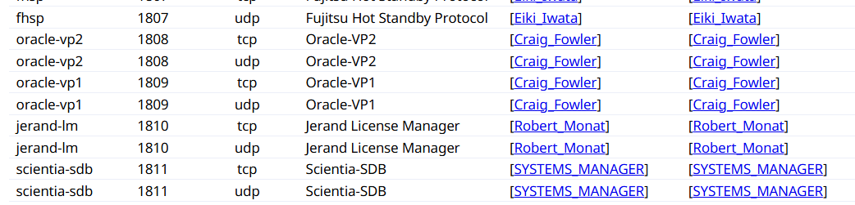
Some registered Ports
Port 1809 (TCP) is used for communication between the Oracle Performance Manager or Capacity Planner and the Oracle Intelligent Agent over an SSL connection
https://www.iana.org/assignments/service-names-port-numbers/service-names-port-numbers.xhtml

Slide 24
TCP -Establishing Connection
Key Steps:
Sequence numbers agreement:
  Each side starts with an agreed initial sequence number.
  For example:
    A starts with sequence 104.
    B starts with sequence 68.
Handling lost or delayed packets:
  Sender waits for an acknowledgment (ACK).
  If no ACK, the sender retransmits the packet..
Potential issues:
  Lost ACKs may trigger retransmissions.
  Late packets can confuse a new connection..

Slide 25
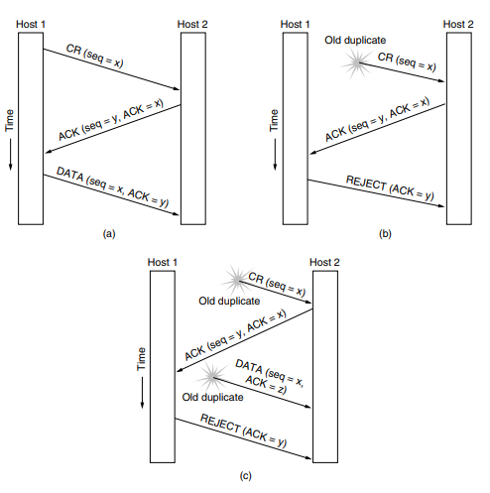
TCP - 3-Way Handshake Steps
1. Connection Request (CR):
  Host 1 sends a CR with a random Sequence Number (SN).
2. Acknowledgment (ACK):
  Host 2 responds with an ACK including:
    Host 1’s SN.
    Its own new SN.
3. Data Transfer Start:
  Host 1 sends the first data packet with both sequence numbers.
  Old/outdated packets are ignored.

Slide 26
TCP - Flow Control and Congestion Control
Main goals:
  Prevent network overload.
  Ensure efficient data transfer.
1. Flow control
  Manages data flow between sender and receiver.
  Sliding Window Protocol:
    Allows multiple packets before acknowledgment.
    Controls data rate efficiently.
2. Congestion Control
  Prevents network overload by adjusting transmission rates.
  TCP Mechanism:
    Reduces transmission rate during congestion.
    Maintains network stability.

Slide 27
Summary
Transport Layer:
  Ensures reliable communication between applications.
  Key Protocols: TCP (reliable) and UDP (fast, connectionless).
  Functions: Segmentation, reassembly, error handling, flow control.
  Establishes connections using the 3-way handshake process.

Slide 28
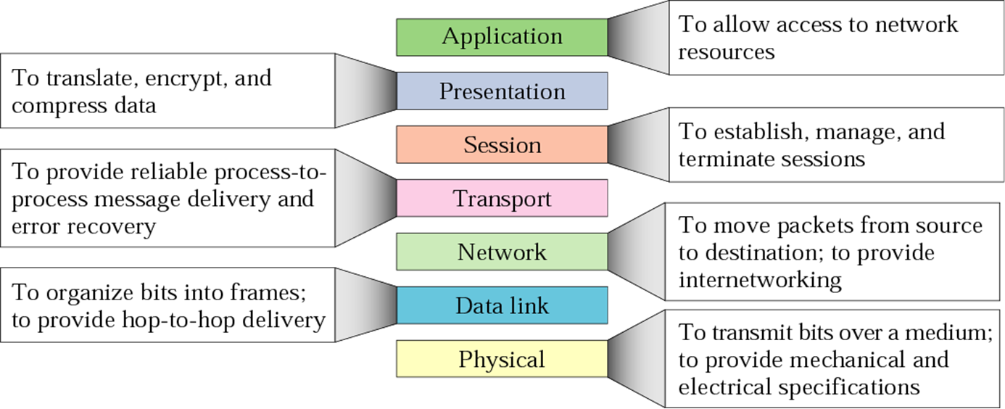
Recap: OSI Model

Slide 29
Recap: Data Transformation Through the Layers
Application Layer:
  Data: In raw form.
Transport Layer:
  Segment: Data + Transport Header (e.g., sequencing, error handling, port numbers).
Network Layer:
  Packet: Segment + Network Header (e.g., source and destination IP addresses).
Data Link Layer:
  Frame: Packet + Link Header/Footer (e.g., MAC addresses, error detection).
Physical Layer:
  Bits: Frame → Transmitted as 0s and 1s.

Slide 30
Application Layer
The top layer of the OSI and TCP/IP models.
Provides interfaces for users and applications to access network services.
Enables communication between user applications (e.g., web browsers, email clients) and lower network layers.
Some specific application layer protocols
  DNS (Domain Name System)
  HTTP (Hypertext Transfer Protocol)
  FTP (File Transfer Protocol)
  DHCP (Dynamic Host Configuration Protocol)
  SMTP (Simple Mail Transfer Protocol)

Slide 31
DNS - Domain Name System
DNS translates domain names (e.g., google.com) into IP addresses for easy access to websites.
Enables humans to use symbolic names instead of numerical IP addresses (e.g. www.cs.le.ac.uk).
Hierarchical Structure:
  Managed by domain registrars for domain name registration.
  Includes:
    Generic domains: (e.g., .com, .edu, .org).
    Country-specific domains: (e.g., .uk, .jp, .au).

Slide 32
DNS Hierarchy and Structure
DNS is structured in levels which are:
  Root:
    The top-most level in the DNS hierarchy represented by a dot ( . )
      The root connects all the top-level domains (TLDs), like .com, .org, and .uk.
  Top-Level Domain (TLD):
    The first part after the root, defining the domain's type or geographic location:
      Generic TLDs (gTLDs):
        .com (commercial)
        .org (organisations)
        .edu (educational institutions in the US)
      Country Code TLDs (ccTLDs):
        .uk (United Kingdom)
        .jp (Japan)
        .au (Australia).

Slide 33
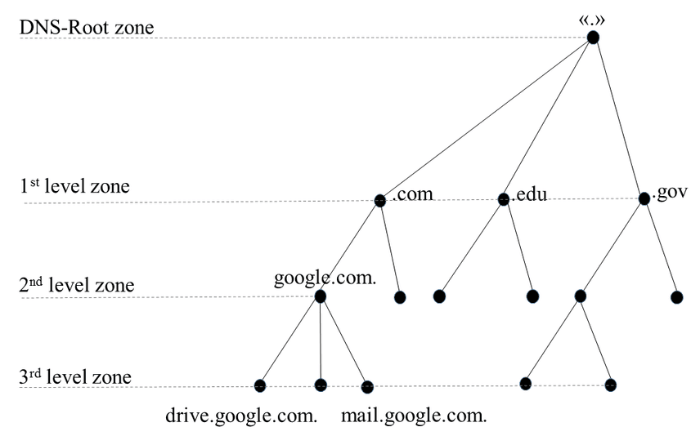
DNS Hierarchy and Structure
Second-Level Domains:
  Below the TLD (e.g. .uk).
  Identifies an organisation or entity (e.g., ac for academic institutions in the UK).
Third-Level Domains:
  Subdivision of the second-level domain.
  Represents specific institutions, divisions, or organisations.
Subdomains:
  Further subdivisions for departments or functions.
Host (e.g. www):
  Specifies a machine or service (e.g., a web server or email server).

Slide 34
Example
www.leicester.ac.uk
Top Level Domain
2nd Level Domain
3rd Level Domain
Host

Slide 35
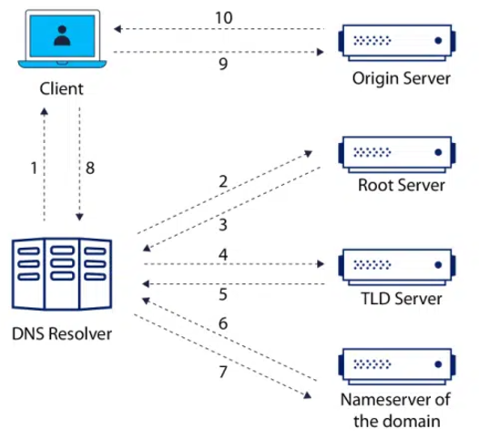
Domain Name Resolution
Name Servers:
  Root: Direct queries to TLD servers.
  TLD: Point to authoritative servers (e.g, .com, .org).
  Authoritative Servers: Provide IP address
Query flow:
  Client → Resolver → Root Server → TLD → Authoritative
For example:
  User enters www.google.com
  Resolver queries servers for IP.
  Browser connects to the IP.
www.google.com
Web Server
www.google.com
.
.com
Checks cache first for
www.google.com
Using DNS Protocol
google.com

Slide 36
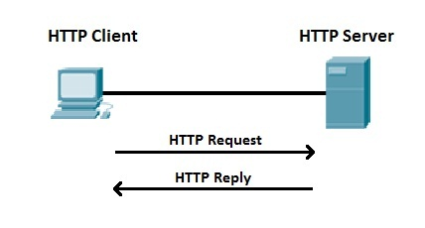
HyperText Transfer Protocol (HTTP)
The protocol that allow communication between web browsers (clients) and web servers.
Each HTTP request is independent; the server does not retain client information (stateless).
HTTP request line contains:
  Method (e.g., GET, POST, PUT, DELETE).
  URL (e.g., /index.html).
  HTTP version (e.g., HTTP/1.1).
  Headers: Provide additional information (e.g., User-Agent, Host(Server URL)).
  Body: Contains data for certain requests (e.g., form submissions in a POST request).
GET /index.html HTTP/1.1
Host: www.example.com
User-Agent: Mozilla/5.0
Connection: close

Slide 37
HTTP Response Structure
Code | Description
200 | OK – Request succeeded.
301 | Moved Permanently – Resource redirected.
404 | Not Found – Resource unavailable.
500 | Internal Server Error – Server problem.
HTTP response components includes:
1. Status line:
  HTTP version (e.g., HTTP/1.1).
  Status code (e.g., 200 OK, 404 Not Found).
2. Headers:
  Information about the response (e.g., content-type, date).
3. Body:
  The requested content (e.g., HTML, JSON, image).
HTTP/1.1 200 OK
Date: Mon, 27 Jul 2009 12:28:53 GMT
Server: Apache/2.2.14 (Win32)
Content-Length: 88
Content-Type: text/html
Connection: Closed
<html>
<body>
<h1>Hello, World!</h1>
</body>
</html>

Slide 38
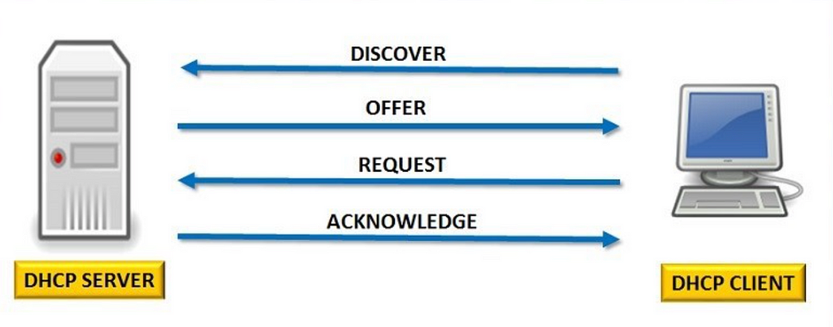
Dynamic Host Configuration Protocol (DHCP)
Automatically assigns IP addresses and network configurations (e.g., subnet mask, gateway) to devices.
Ports:
  Port 67: Server.
  Port 68: Client.
Benefits:
  Eliminates manual IP configuration.
  Reduces IP conflicts in large networks.
How DHCP works:
  Discovery: Client broadcasts a request for an IP.
  Offer: Server responds with an available IP.
  Request: Client accepts the offered IP.
  Acknowledge: Server assigns and confirms the IP.

Slide 39
Simple Mail Transfer Protocol (SMTP)
Protocol for sending emails between clients and mail servers.
Ports:
  Default: Port 25
  Secure (SMTPS): Port 587 or 465.
How SMTP works:
  Client Sends: Email client sends the message to the SMTP server.
  Server Relays: SMTP server forwards the email to the recipient's mail server.
  Recipient Retrieves: Recipient uses IMAP or POP3 to access the email.

Slide 40
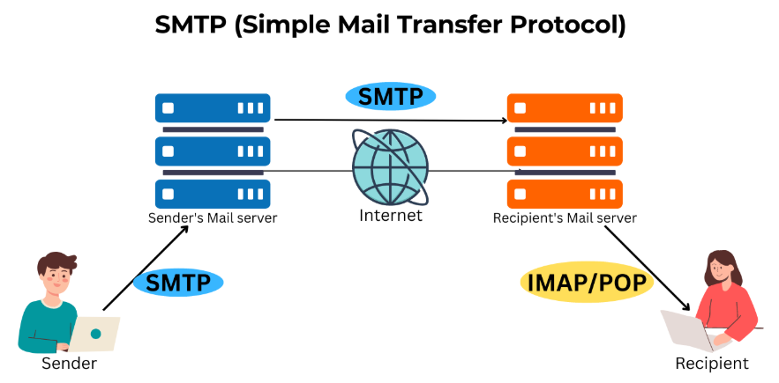
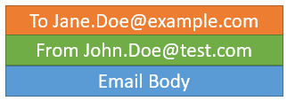
SMTP, IMAP and POP3
SMTP (Simple Mail Transfer Protocol):
  Sending emails
  Transfers outgoing emails to the server.
  Ensures reliable email delivery.
IMAP (Internet Message Access Protocol):
  Receiving emails
  Synchronizes emails across devices.
  Keeps emails on the server.
POP3 (Post Office Protocol version 3):
  Receiving emails
  Downloads emails to a single device.
  Deletes emails from the server.
test.com
example.com

Slide 41
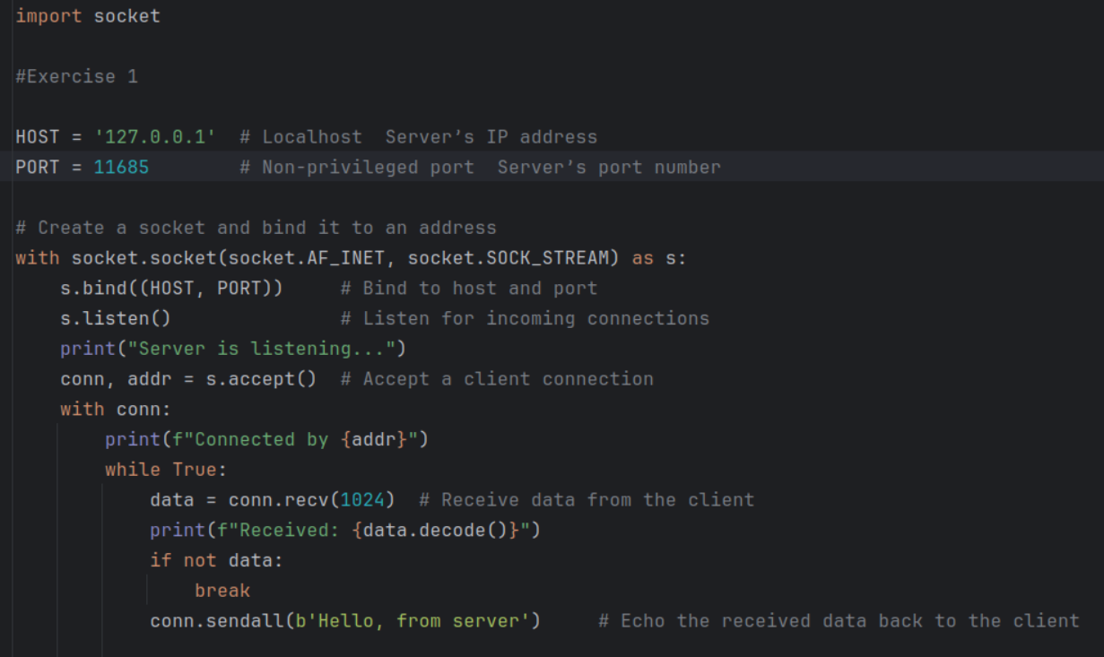
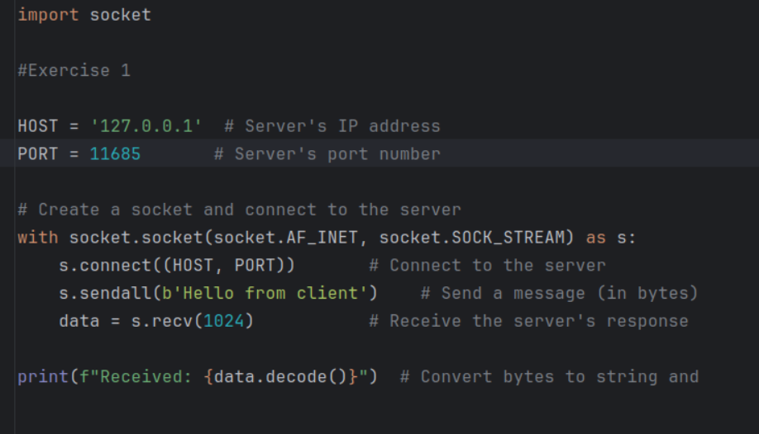
Bespoke Client Server
Application
Bespoke Layer 7 Protocol
127.0.0.1
127.0.0.1
Process
Process
Server Application
Client Application
PORT
32879
Port allocated by OS
Port configured in code
PORT
11685
Socket
Socket
App Data
App Data
TCP/UDP
TCP/UDP
Operating
System
Operating
System
Segment/Packets
[Segment]
[Segment]
Layer 4
Segment
From Port 32879
To Port 11685
Layer 4
Segment
From Port 11685
To Port 32879
Note. Ethernet not used as client
& server are on the same device

Slide 42
Client/Server Applications
In this week lab you will be creating Python client/server applications that communicate via sockets.
We will cover this in more detail in the tutorial

Slide 43
Summary
  DNS resolves domain names to IP addresses.
  HTTP facilitates communication between web browsers and servers.
  DHCP automates IP address assignment, reducing manual configuration.
  Email protocols:
    SMTP (sending), IMAP (syncing), and POP3 (downloading emails).
Next week . . .
  Revision

